Slide 1
Helm

Slide 2
K8s Deployment Challenges
Move to microservice architecture
application consists from multiple components
each component has its own resources and can be scaled individually
It’s hard to
manage, edit and update multiple K8s configurations
deploy multiple K8s configuration as a SINGLE application
share and reuse K8s configurations and applications
parametrize and support multiple environments
manage application releases: rollout, rollback, diff, history
define deployment lifecycle (control operations to be run in different phases)
validate release state after deployment

Slide 3








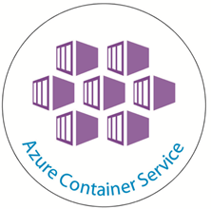
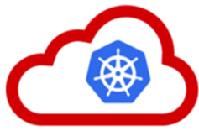

Kubernetes / Helm
Helm was jointly started by Google and Deis
Helm is a Kubernetes project now (managed by CNCF)
Active community: Google, Microsoft, Bitnami, …
kubeapps.com - curated list (repository) of Helm Charts
Works with any K8s cluster: K8s, Minikube, GKE, ACS, …

Slide 4
What is Helm?
Helm is a Package Manager for Kubernetes
package multiple K8s resources into a single logical deployment unit: Chart
… but it’s not just a Package Manager
Helm is a Deployment Management for Kubernetes
do a repeatable deployment
management dependencies: reuse and share
manage multiple configurations
update, rollback and test application deployments (Releases)

Slide 5
Helm dictionary
Chart - a package; bundle of Kubernetes resources
Release - a chart instance is loaded into Kubernetes
same chart can be installed several times into the same cluster; each will have it’s own Release
Repository - a repository of published Charts
Template - a K8s configuration file mixed with Go/Sprig template

Slide 6
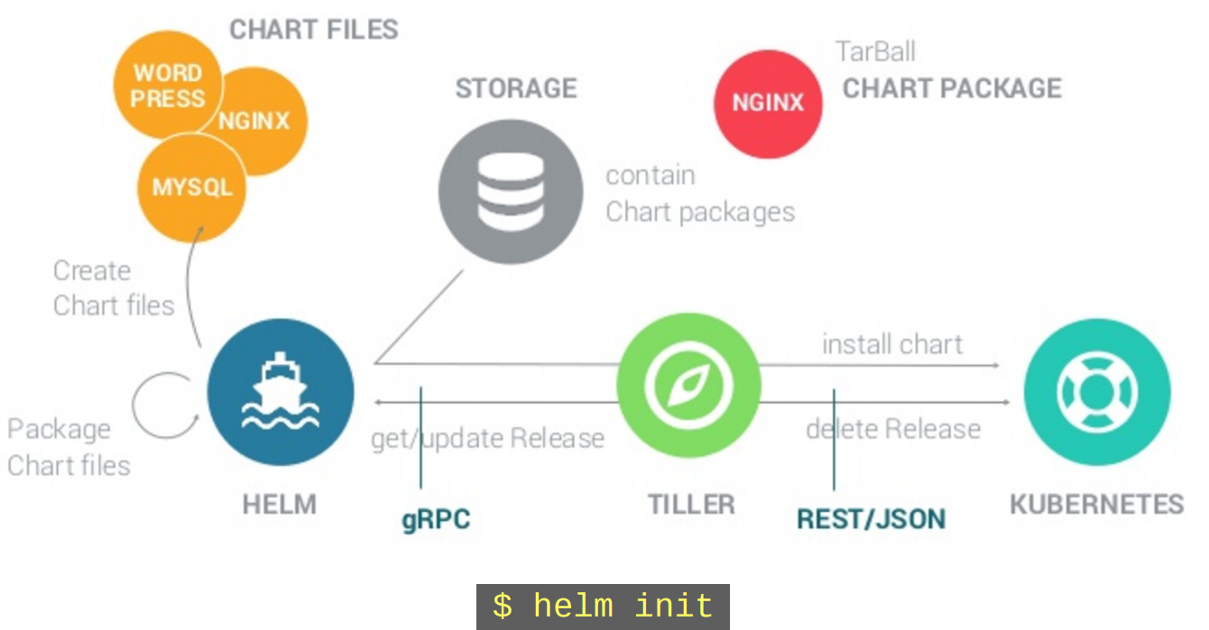
Helm architecture

Slide 7


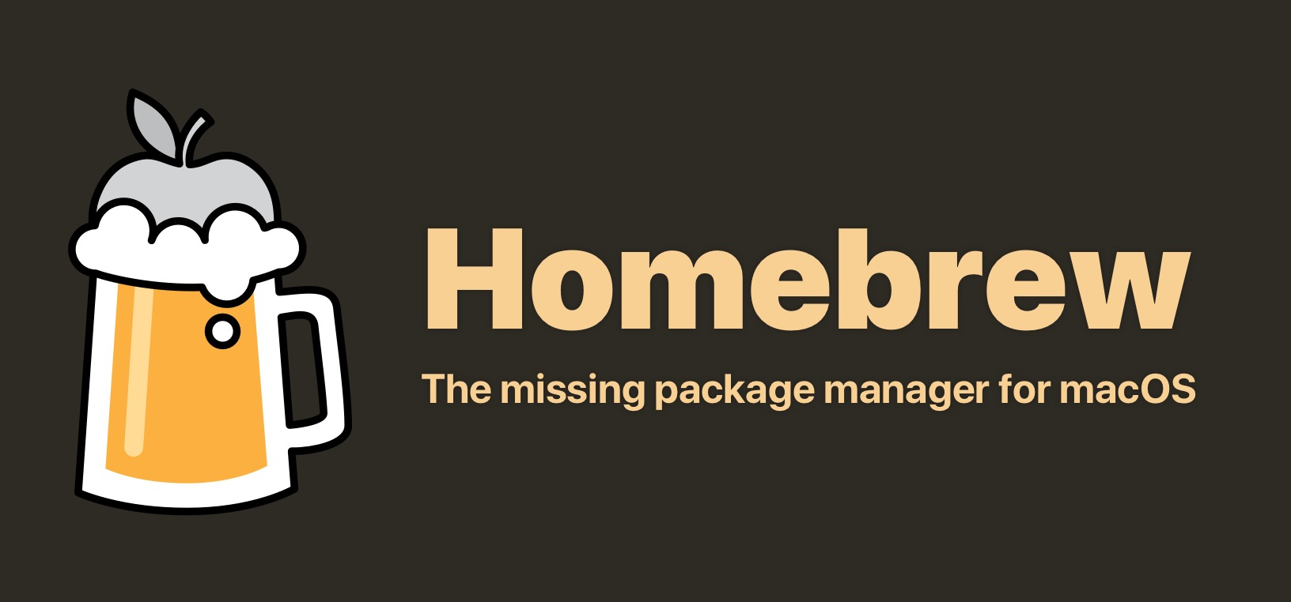
Helm installation
Ubuntu / snap
snap install helm –classic
MacOS / homebrew
brew install kubernetes-helm
Windows / chocolatey
choco install kubernetes-helm

Slide 8
Helm commands
Charts
helm create Creates a new chart with a given name
helm package Creates a .tgz file of the chart
helm install Installs a chart (and adds it to a local repository)
helm lint Validates the generated charts
Releases
helm list Lists releases
helm delete Deletes a release
helm upgrade Upgrades a release
helm rollback Rolls back a release to a previous version
helm get Downloads a release
Repositories
helm repo Add, remove, list repositories
helm serve Hosts a local Helm repository

Slide 9
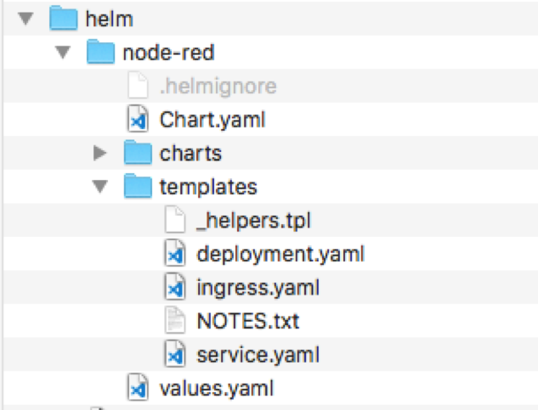
Helm chart
Chart metadata
Name, version, replica’s, labels
Templates
Kubernetes deployment yamls
With placeholders / template script
Values
Variables for use in templates

Slide 10
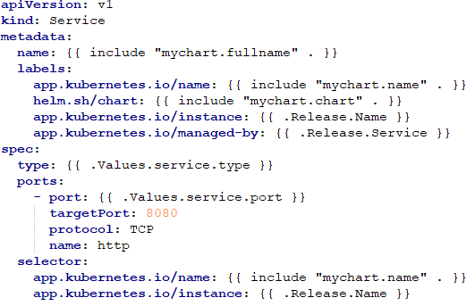
Helm service template
service.yaml
From _helpers.tpl
Based on Chart.yaml and values.yaml
From _helpers.tpl
Based on Chart.yaml and values.yaml
From values.yaml

Slide 11
Helm weaknesses
Project relative immaturity - it's a young project
No built-in environment support
Non informative logs on failures (it's also a K8s issue)
Weak linter: too many errors skip linter checks
Open Issues:
subcharts are ignored when there is a requirements.yaml
the --recreate-pods tag is does not recreate pods of statefulsets

